Slide 1

Customer Segmentation and Personality Analysis

Slide 2

Project Mentor:
Dilavar Basha
Group – II Members:
Arya Krishna A
Mohammed Shadab Hussain
Kruthika
Devesh Gaonkar

Slide 3
PROJECT ARCHITECTURE
Business Objective
Data Collection
Data Pre-processing
Model selection
Feature Engineering
EDA
Model Training
Model Evaluation
Deployment

Slide 4
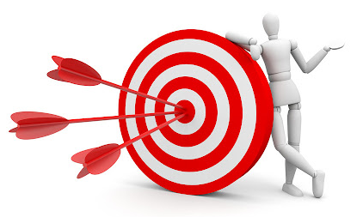
Business Objective
Customer personality analysis helps a business to modify
its product based on its target customers from different types of customer segments.
Finding the potential customers by analysing the behaviour of them is useful to understand the targeted customers.
For example, instead of spending money to market a new product to every customer in the company’s database, a company can analyse which customer segment is most likely to buy the product and then market the product only on that particular segment.

Slide 5
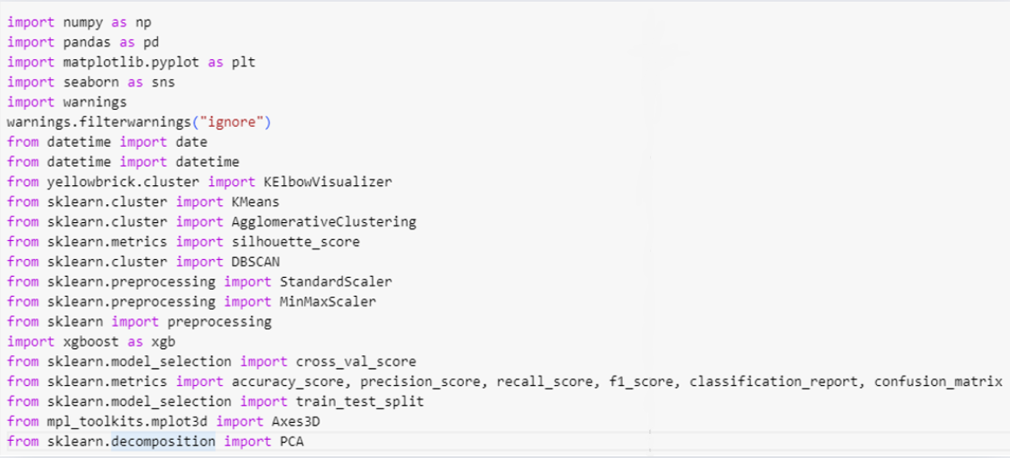
Importing the Libraries

Slide 6
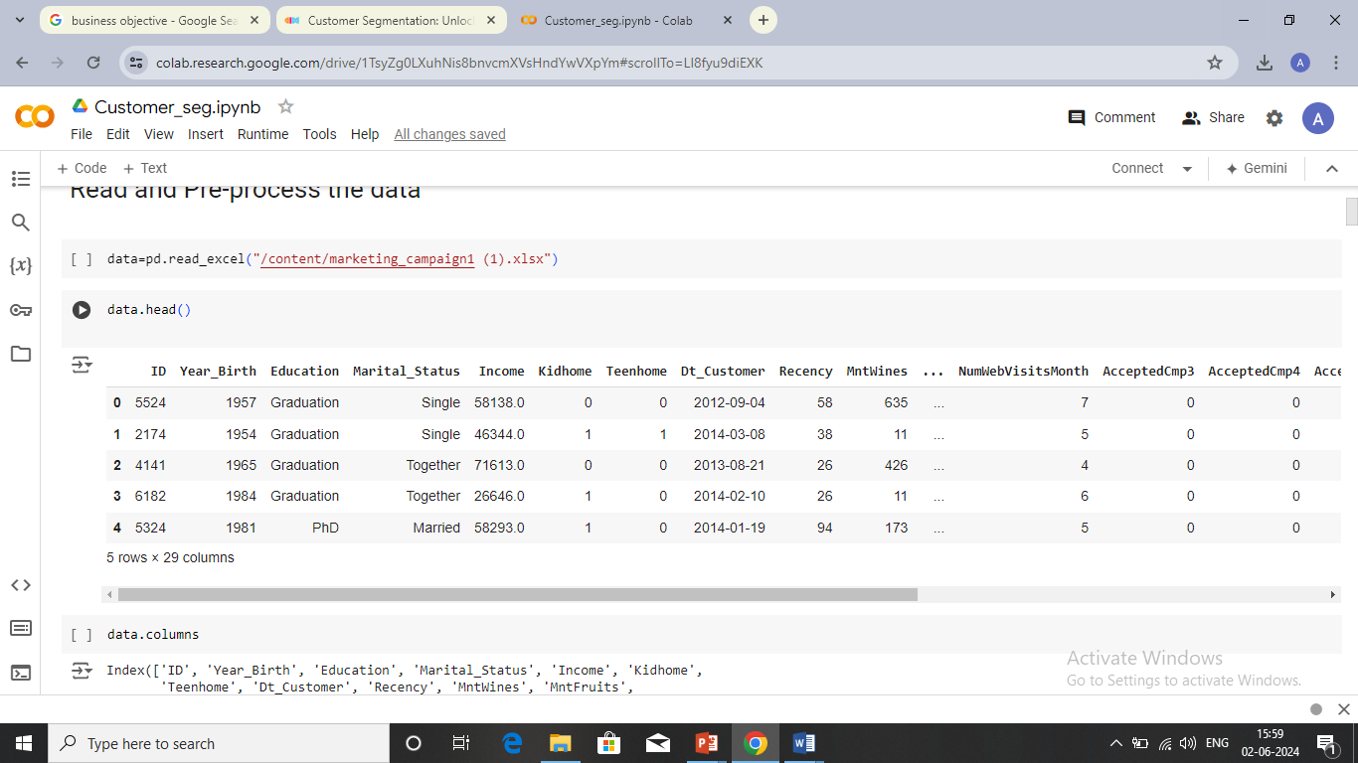
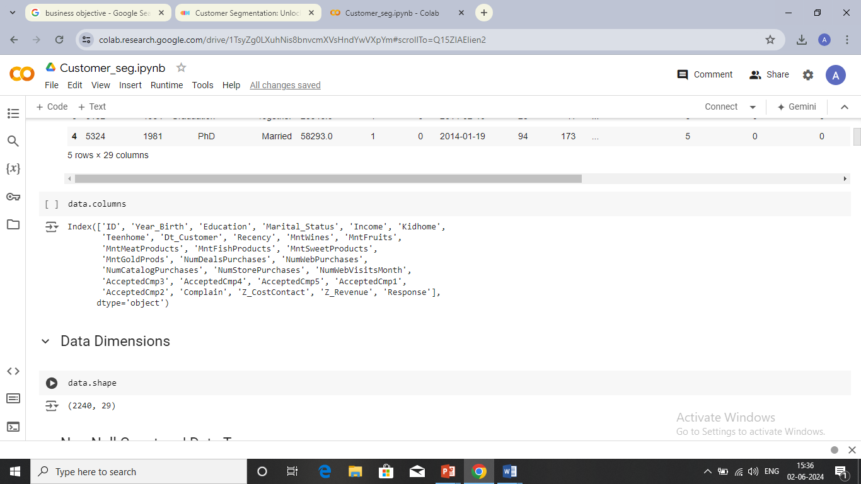
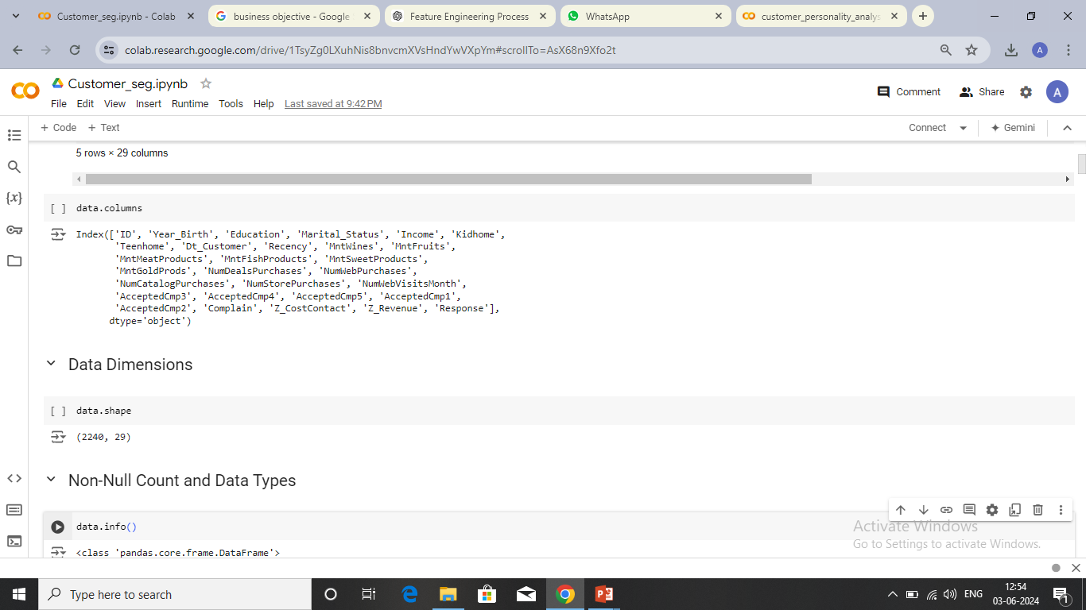
Data Overview

Slide 7
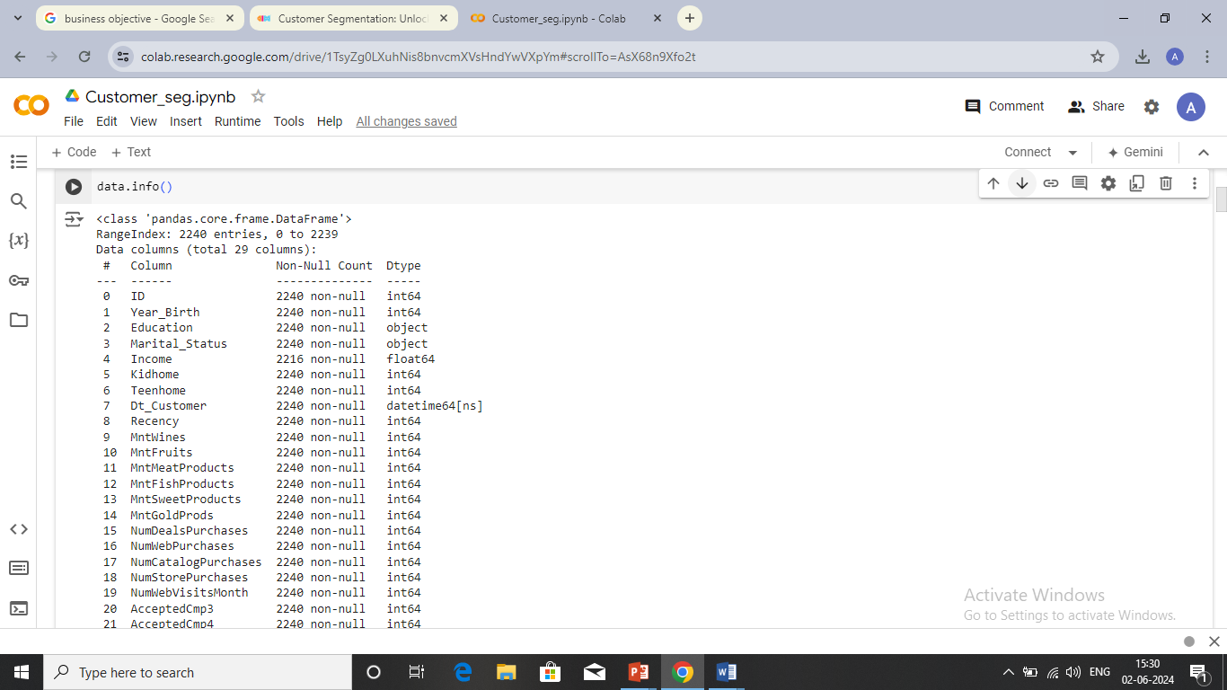
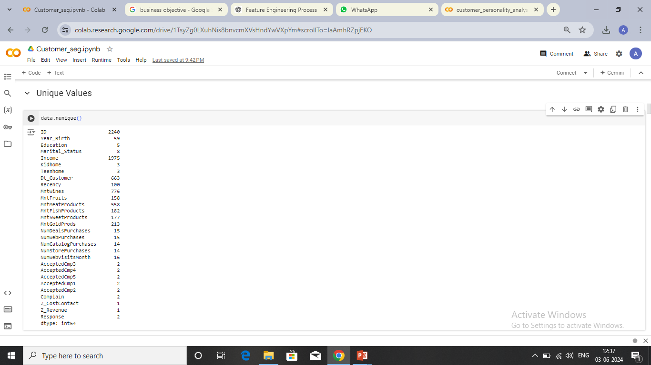
Non-Null Counts and Data types
Unique Values
There are missing values in the column income.
The data type of the column year_birth should be in datetime format, here it is given as int.
The data.nunique() function reveals the uniqueness and variety of data within each column, which is essential for understanding the distribution and diversity of the dataset.

Slide 8
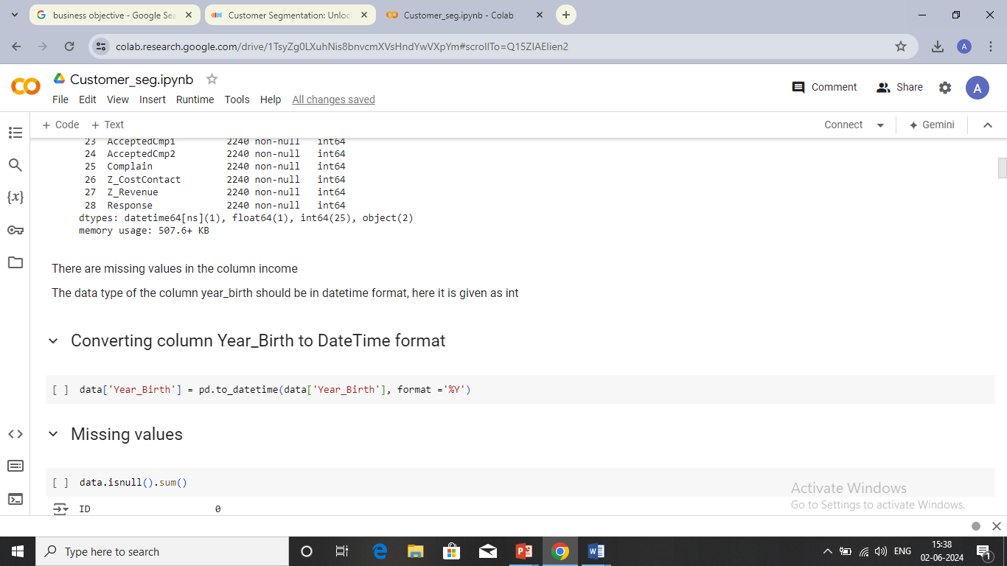
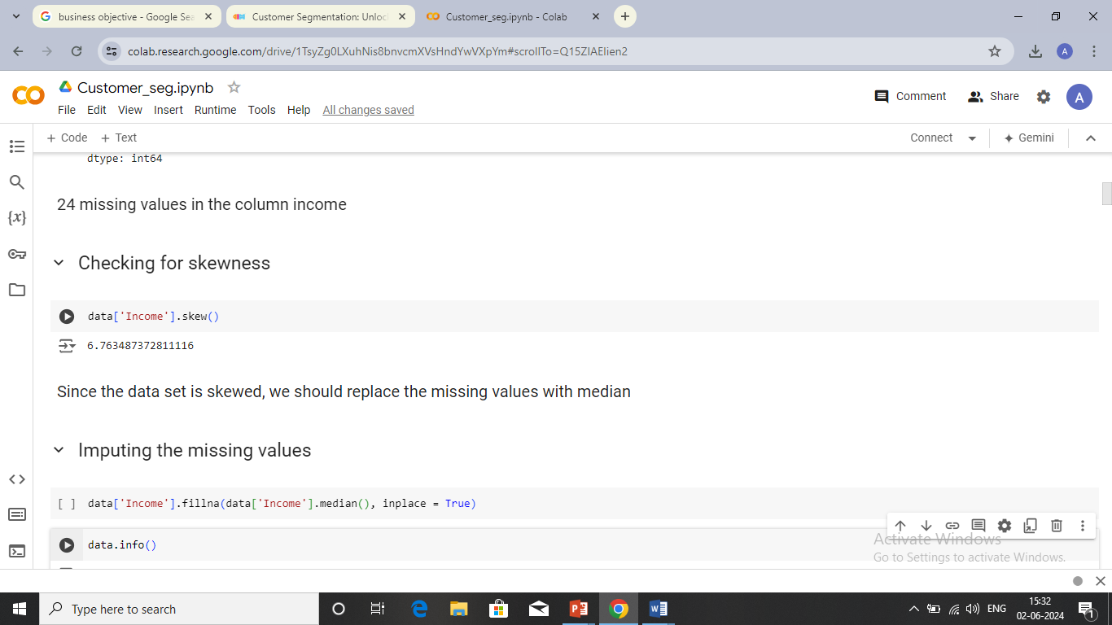
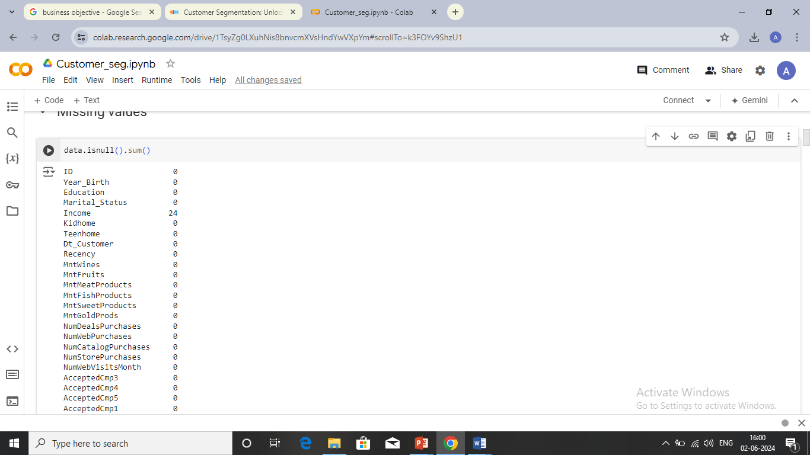
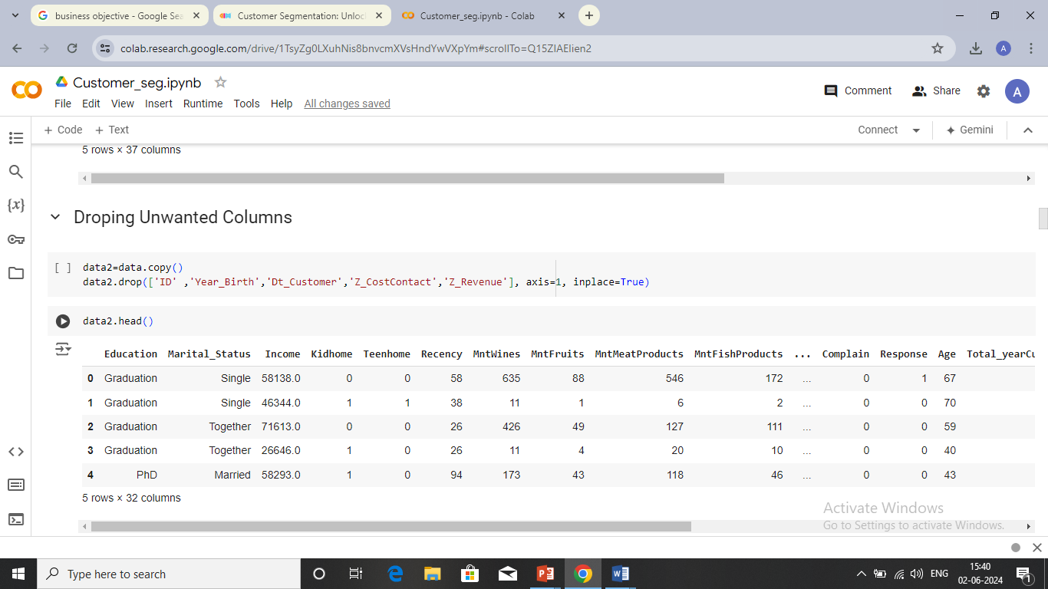
Data cleaning
Checking for Null Values

Slide 9
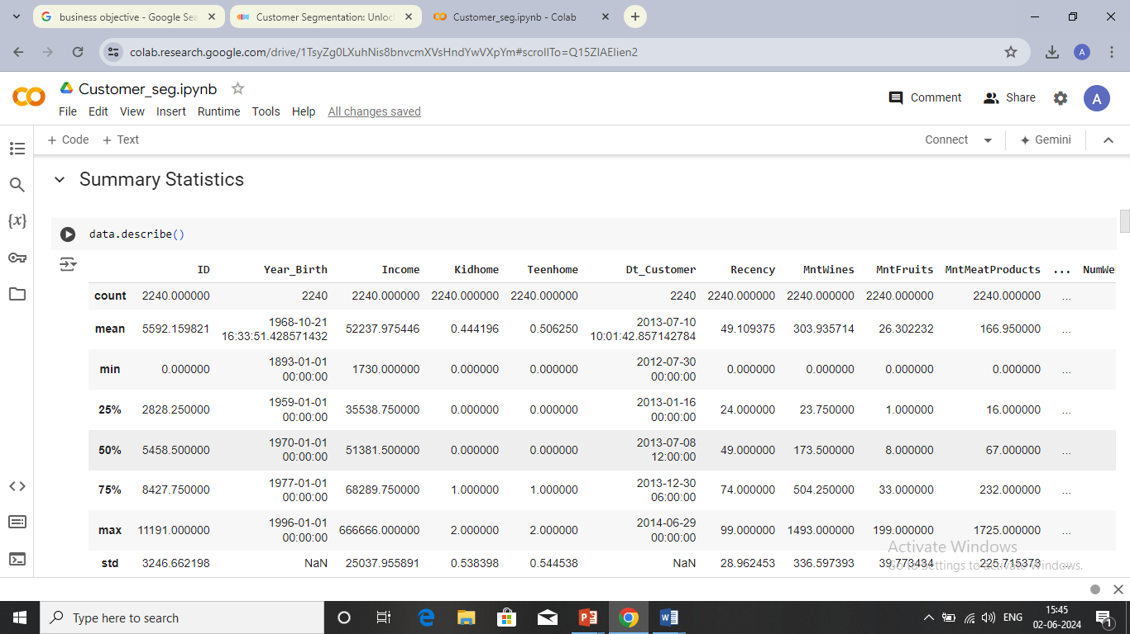
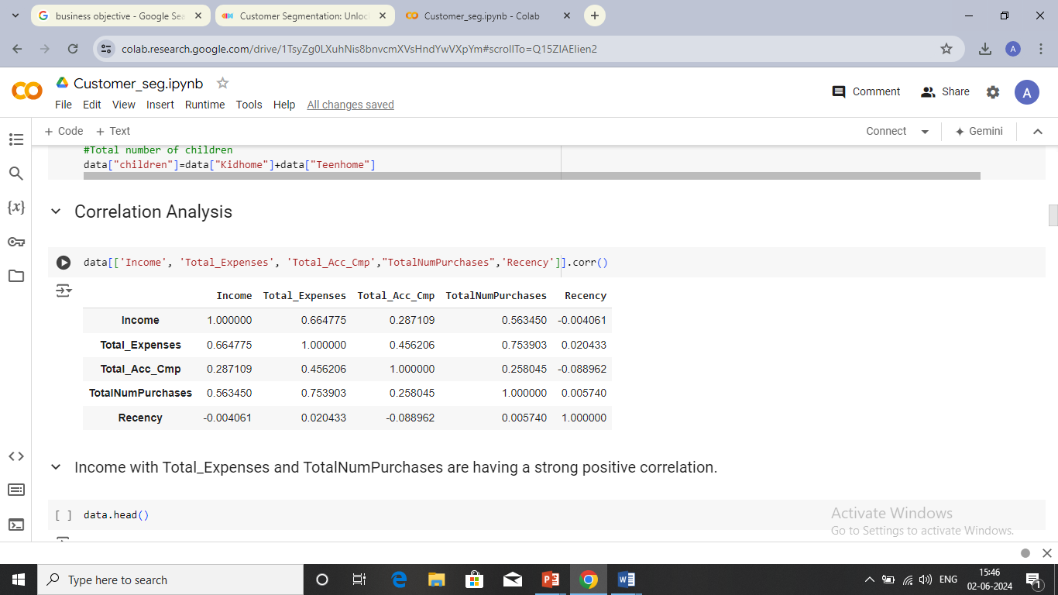
Correlation analysis and summary statistics
There is a strong positive correlation between Income and Total Expenses as well as Total Expenses with TotalNumPurchases.
There is a negative correlation between Income and Recency.
This method provides a quick overview of the dataset, helping us to understand its structure and distribution.

Slide 10
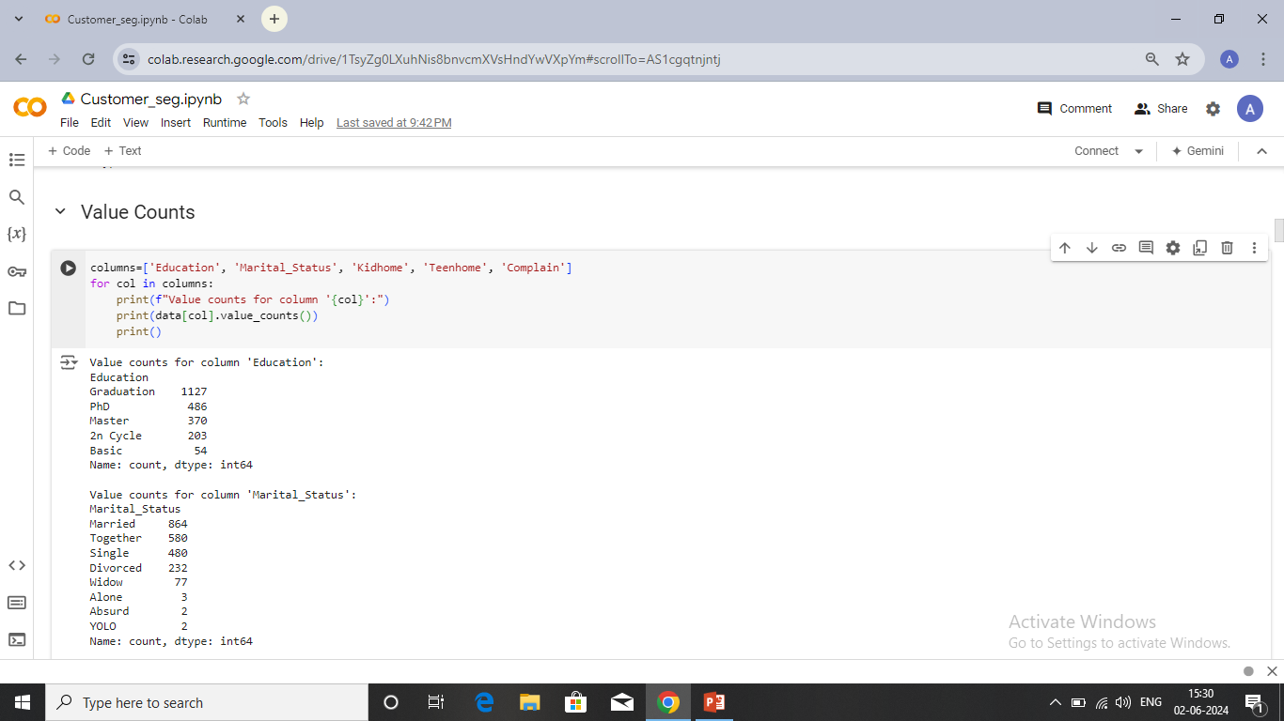
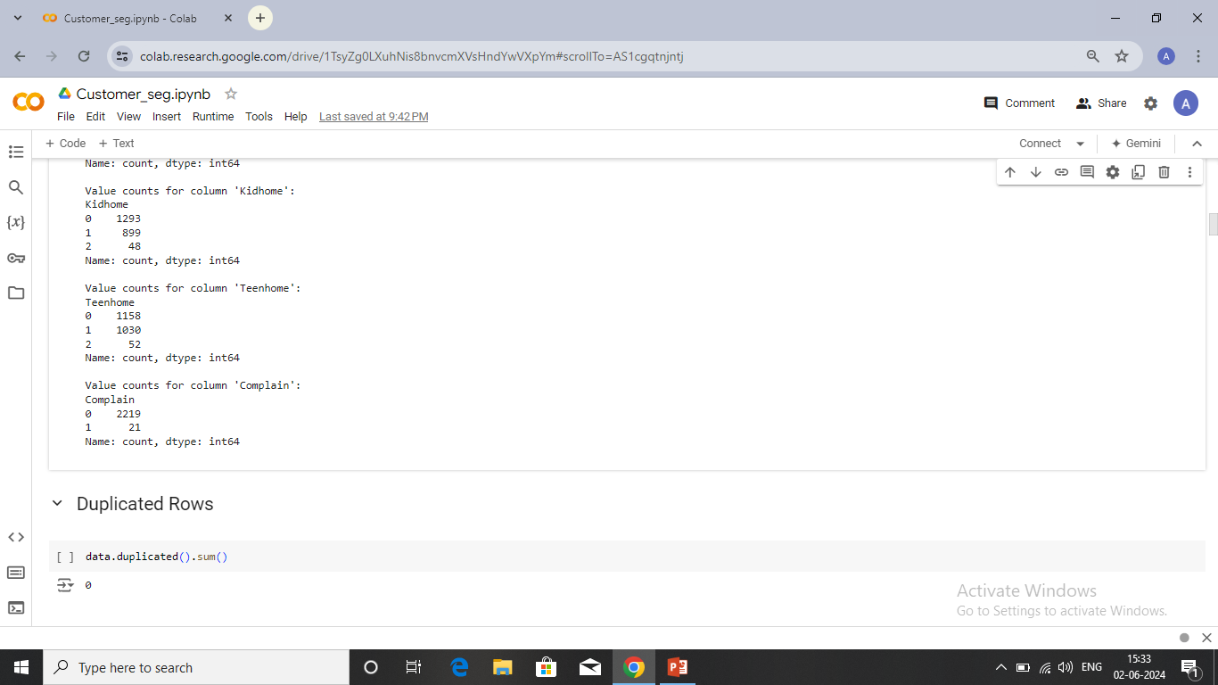
Value counts and duplicated rows
There are no duplicate entries in this dataset

Slide 11
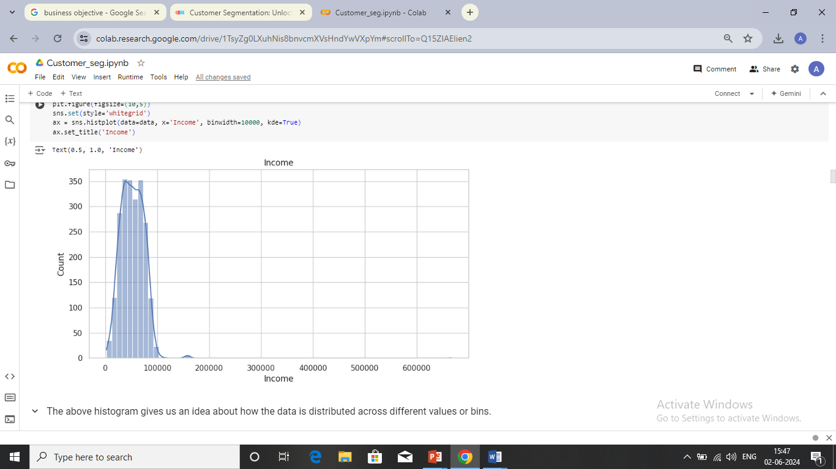
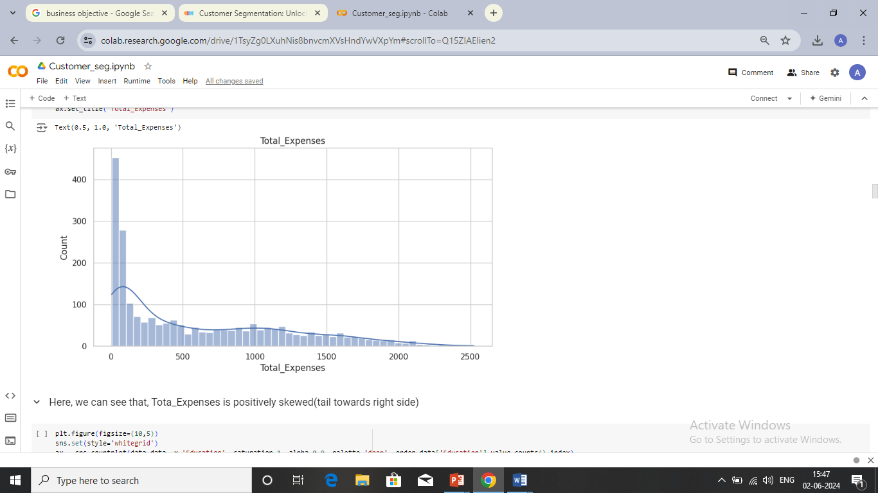
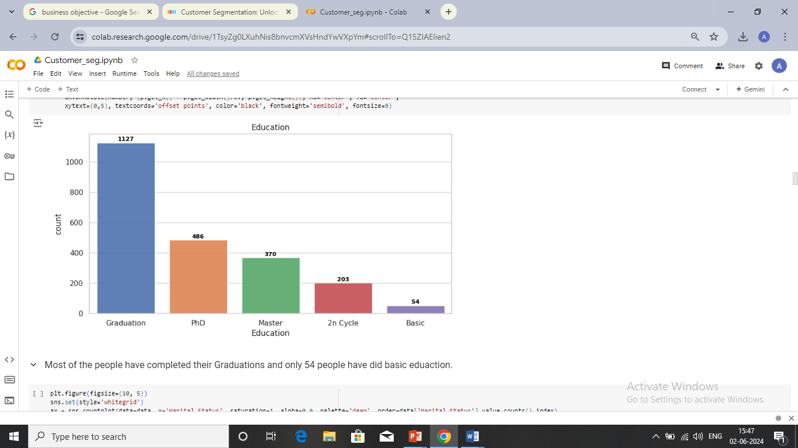
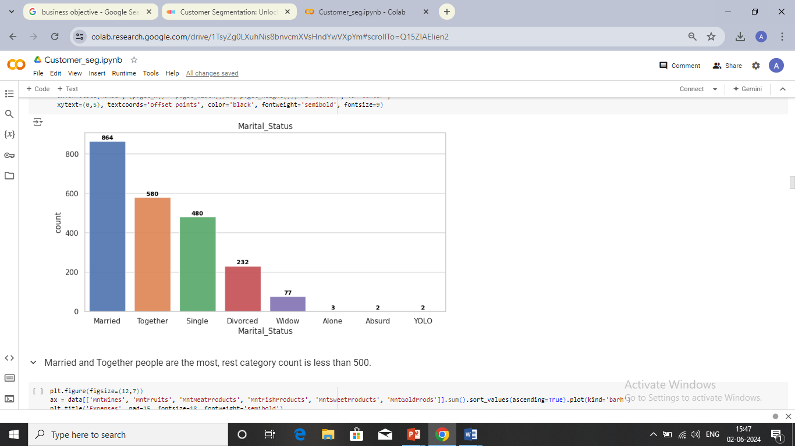
Data visualization
Histplot
Count Plot

Slide 12
Income vs. Count
The above histogram gives us an idea about how the data is distributed across different values or bins.
It allows us to visually identify whether the data is positively skewed (tail to the right), negatively skewed (tail to the left), or approximately symmetric.
Here, we can see that, it is approximately symmetric, normally distributed.
Total Expenses vs. Count
Here, we can see that, Total Expenses is positively skewed(tail towards right side).
Education vs. Count
Most of the people have completed their Graduations and only 54 people have done basic education.
Marital Status
Married and Together people are the most, rest category count is less than 500.

Slide 13
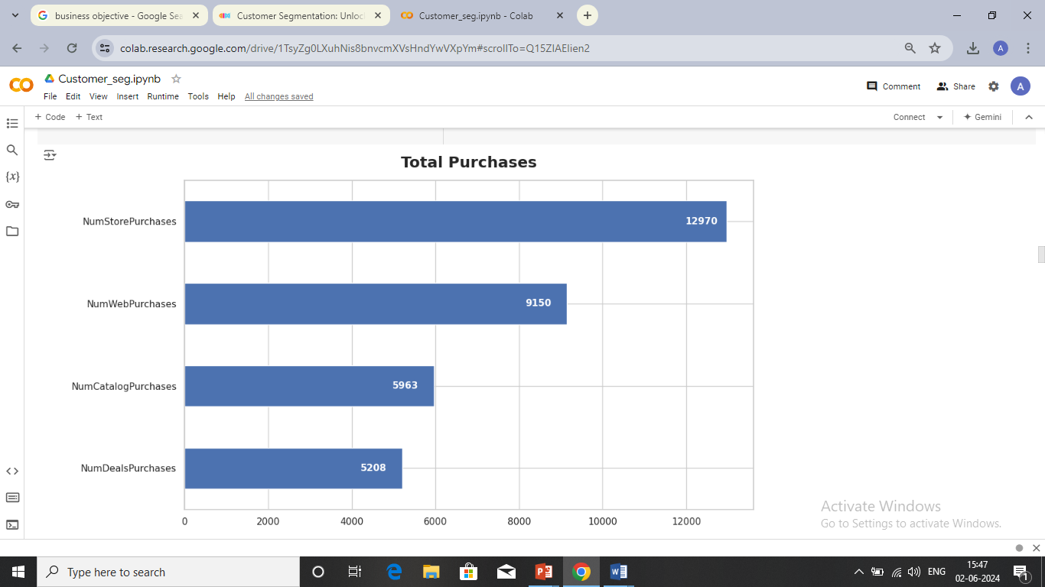
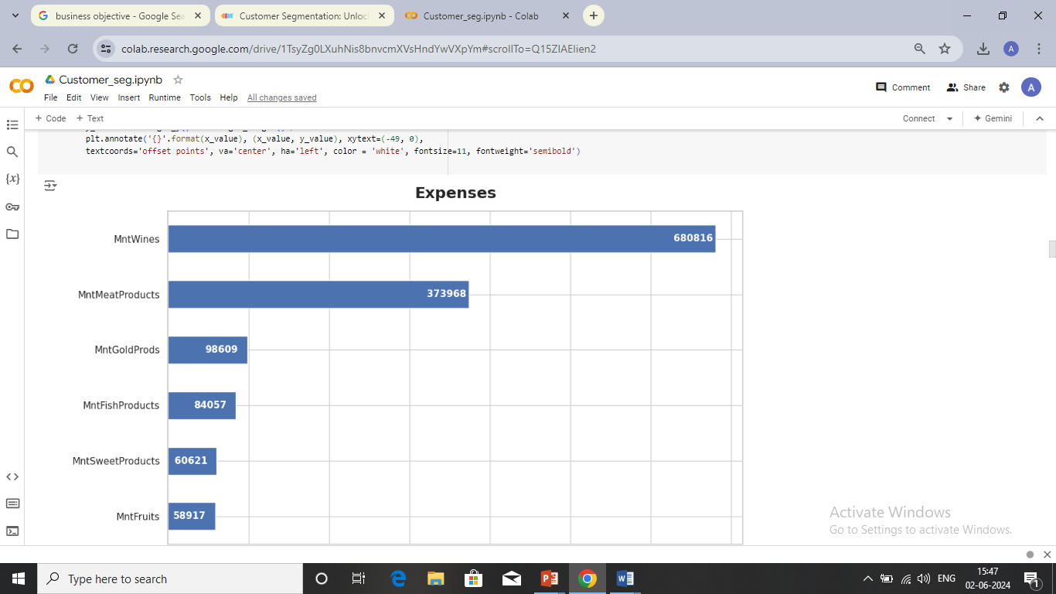
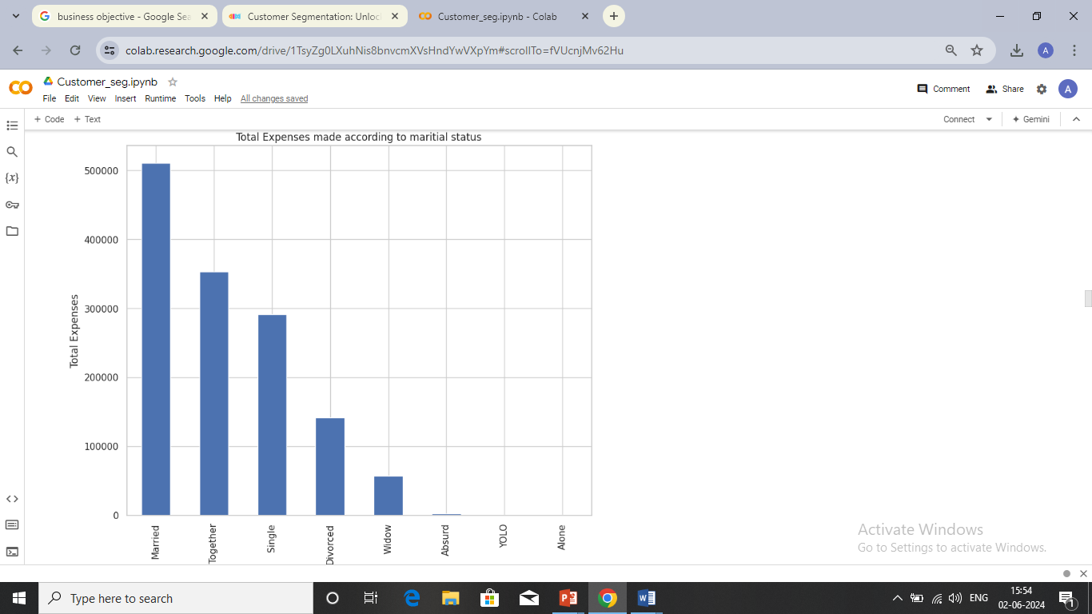
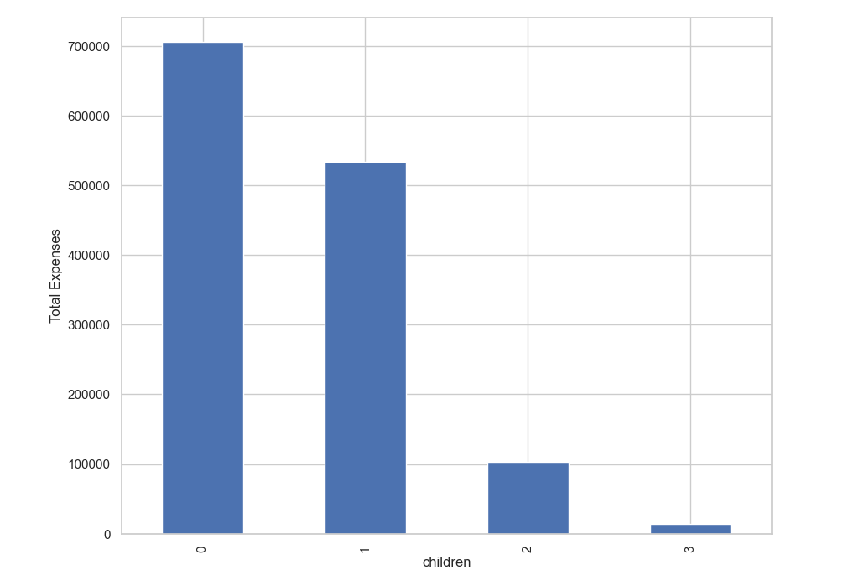
Bar Plot

Slide 14
Expenses
Most of the expenses are made on the purchase of wine, while the least is spent on fruits.
Total Purchases
About 12,970 purchases are made directly in stores, while 5,208 are made through deals.
Total Expenses by Education Level
Most of the expenses are made by households with graduates, while the least is made by households where individuals have only completed basic education.
Total Expenses vs. Children
Larger Expenses are made by the households that have at least 1 child.

Slide 15
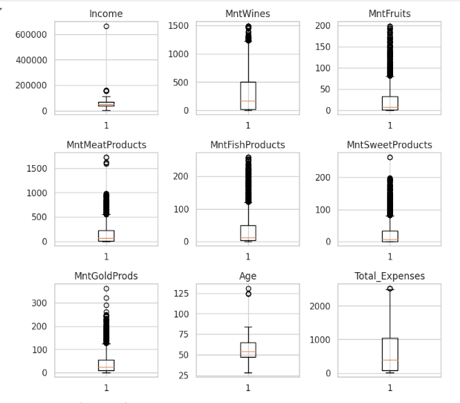
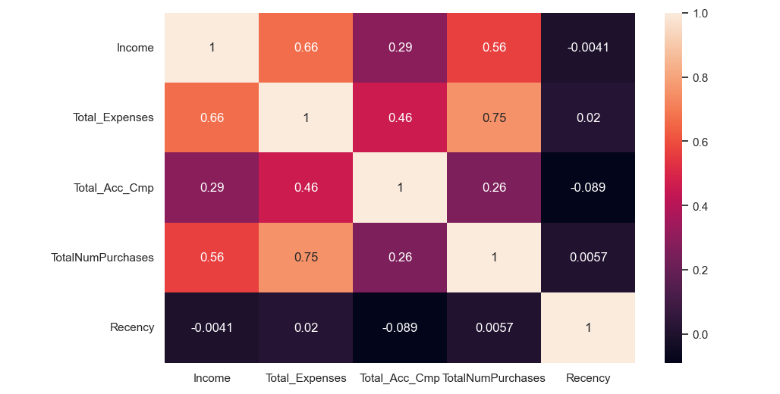
Boxplot & Heat Map
There were a few outliers in each of the columns, which were replaced by the threshold values.
The highest correlation is between income and total expenses, followed by total expenses and total accepted campaigns.

Slide 16
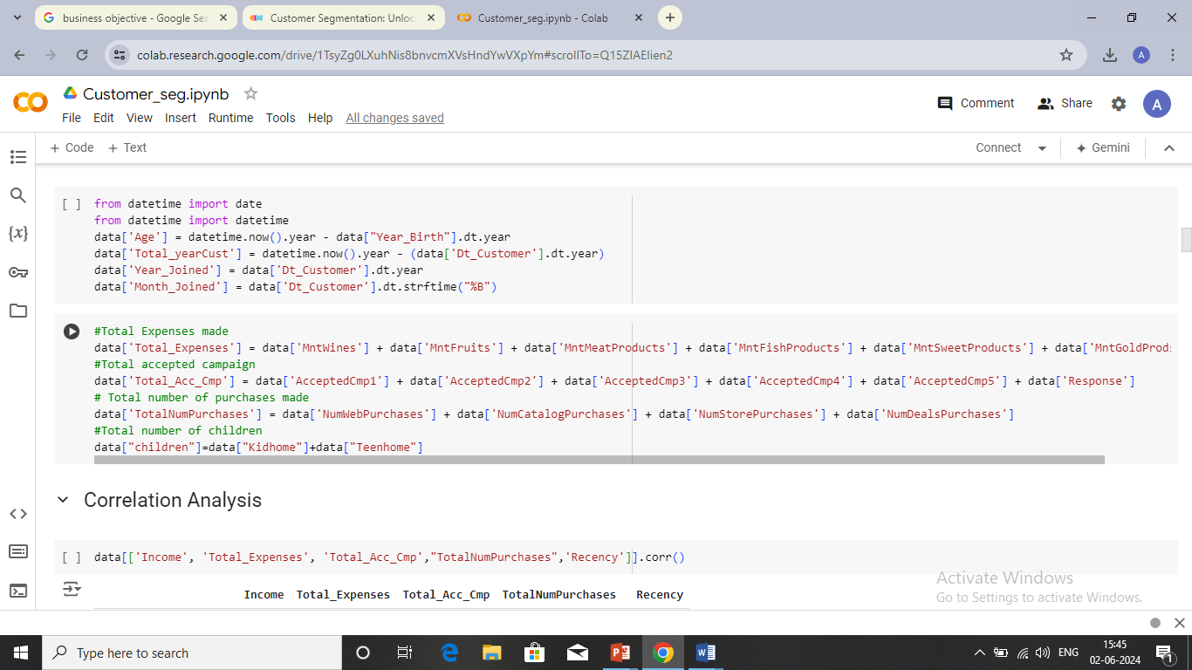
Feature engineering
Extracted the age of each customer by subtracting the year of birth (Year Birth) from the current year.
Calculated the total number of years each customer has been with the company by subtracting the year they joined (Dt_Customer) from the current year.
Extracted the month and year of joining the company by the customer
Total Expenses were calculated by summing up the spending on different product categories (wines, fruits, meat products, fish products, sweet products, and gold products).
Total Acc Cmp column, which indicates customer engagement with marketing campaigns, useful for analyzing campaign effectiveness and customer responsiveness to marketing efforts.
TotalNumPurchases column, offering a complete picture of each customer's purchasing activity across various channels
children column, providing demographic information about the customers' households, which can be useful for targeted marketing and understanding the influence of family structure on purchasing behavior.

Slide 17
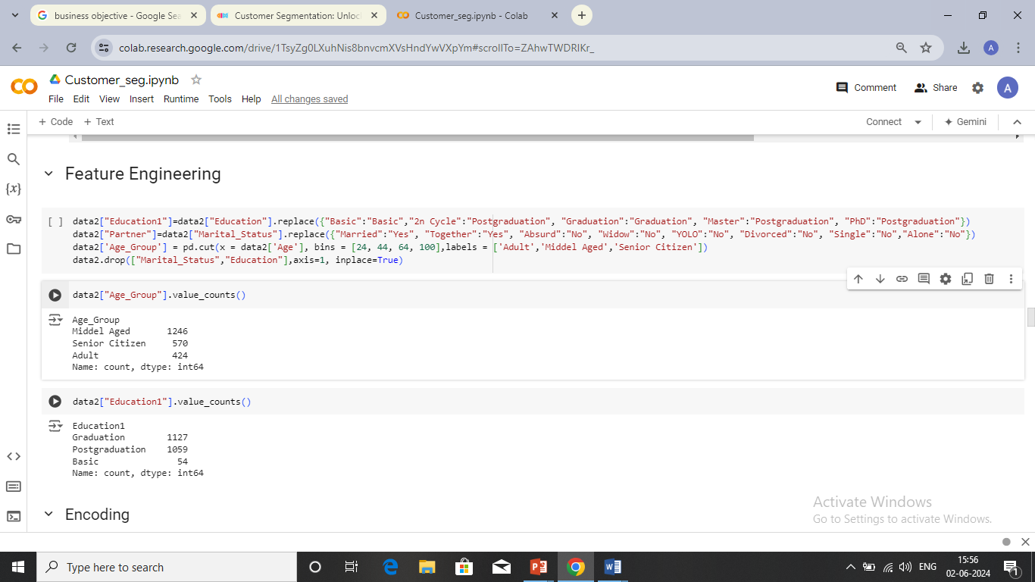
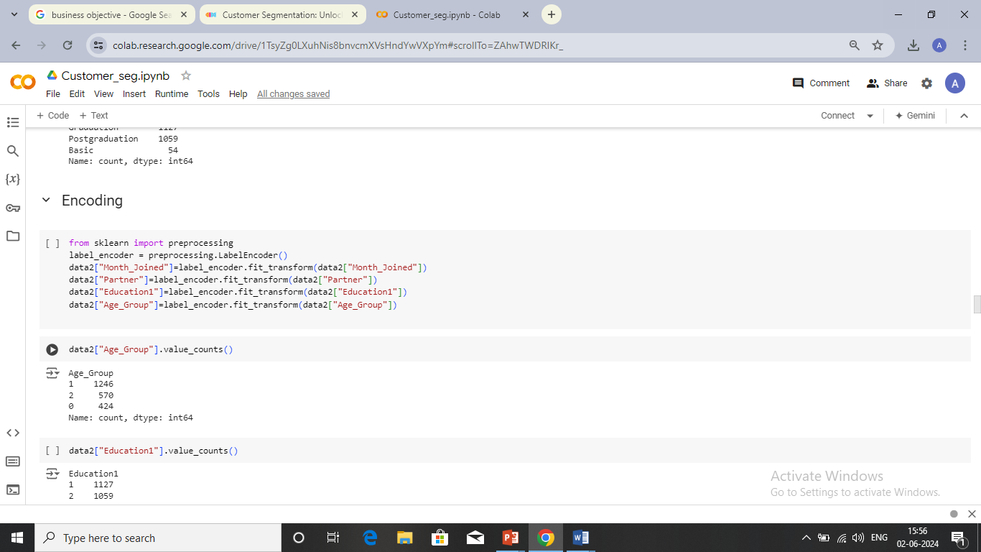
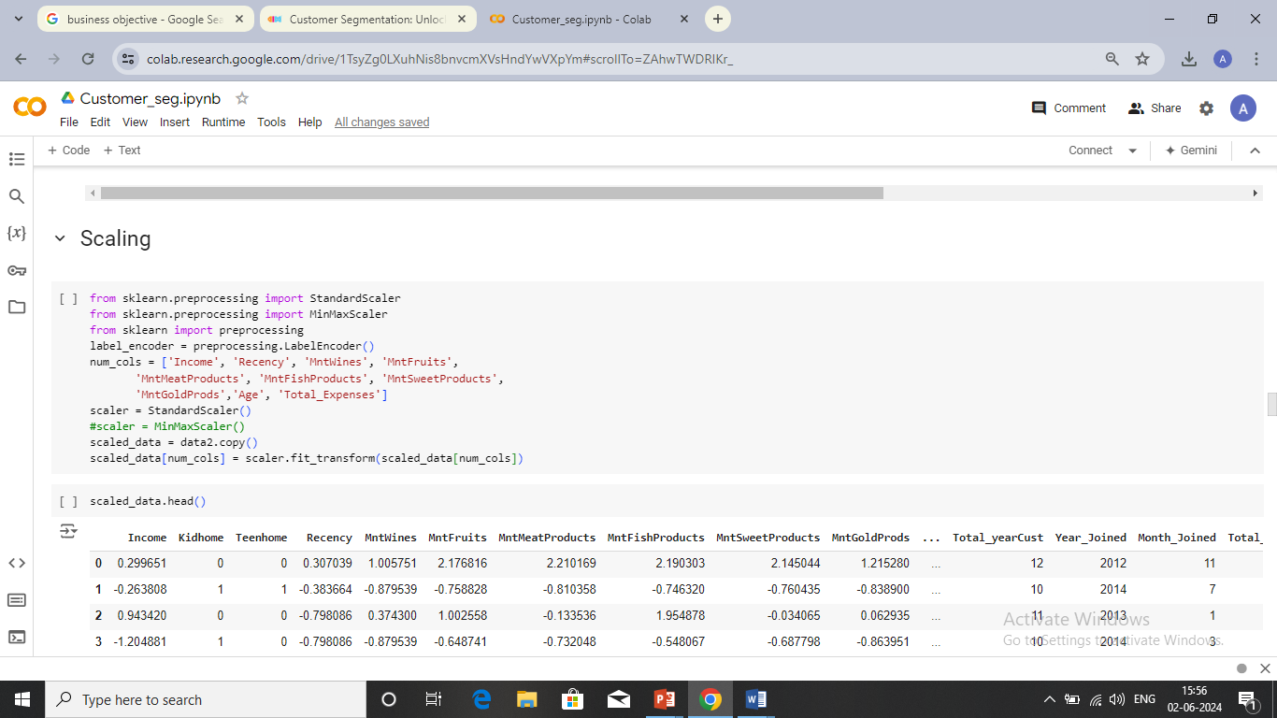
Education1 column, simplifying the education categories into "Basic," "Graduation," and "Postgraduation." This can help in analyzing educational impact on various outcomes without dealing with too many categories.
Partner column, which simplifies the analysis of marital status by categorizing customers as having a partner ("Yes") or not ("No"). This can be useful for understanding the influence of relationship status on customer behavior.
Age_Group segments customers into age categories, aiding in age-related analysis and targeted marketing.
Label Encoding
Label Encoding converts categorical values to numerical values, assigning each category a unique integer.
Scaling
Standard Scaler transforms numerical features to have mean of 0 and a standard deviation 1, making them suitable for algorithms that require normalized input.

Slide 18
Model selection
Sl.No | MODEL | HYPER-PARAMETER | SILHOUETTE SCORE
1. | DBSCAN | eps: 0.3, min_samples: 3 eps: 0.4, min_samples: 3 eps: 0.5, min_samples: 3 | -0.439 -0.439 -0.439
2. | Hierarchical | linkage: ward, affinity: euclidean linkage: complete, affinity: manhattan linkage:average, affinity:manhattan linkage:simple, affinity:manhattan | 0.205 0.166 0.166 0.166
3. | K-Means | K=4 K=5 | 0.26 0.20
This Silhouette score at k=4 (while not very high) suggests that K-Means is able to form somewhat distinct clusters, but there might still be some overlap or outliers. But this score is higher than the silhouette scores obtained from DBSCAN and hierarchical clustering.
So we can conclude that k-means clustering with k=4 would likely provide better clustering results for this dataset.

Slide 19
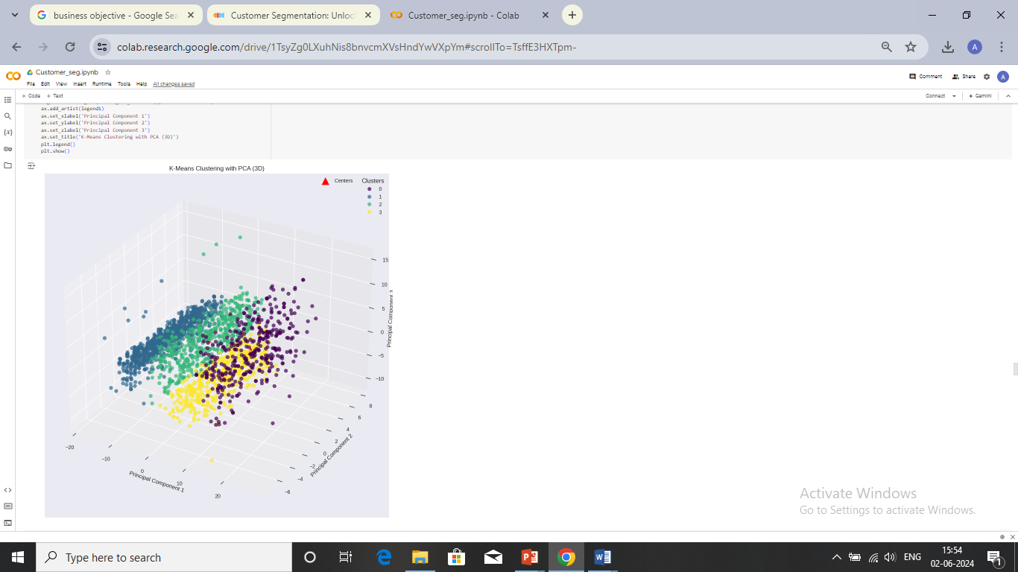
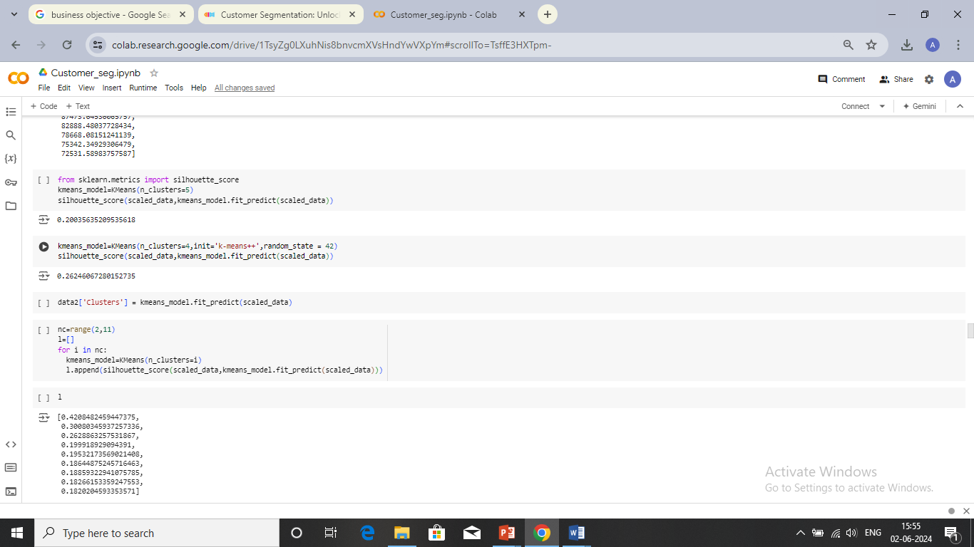
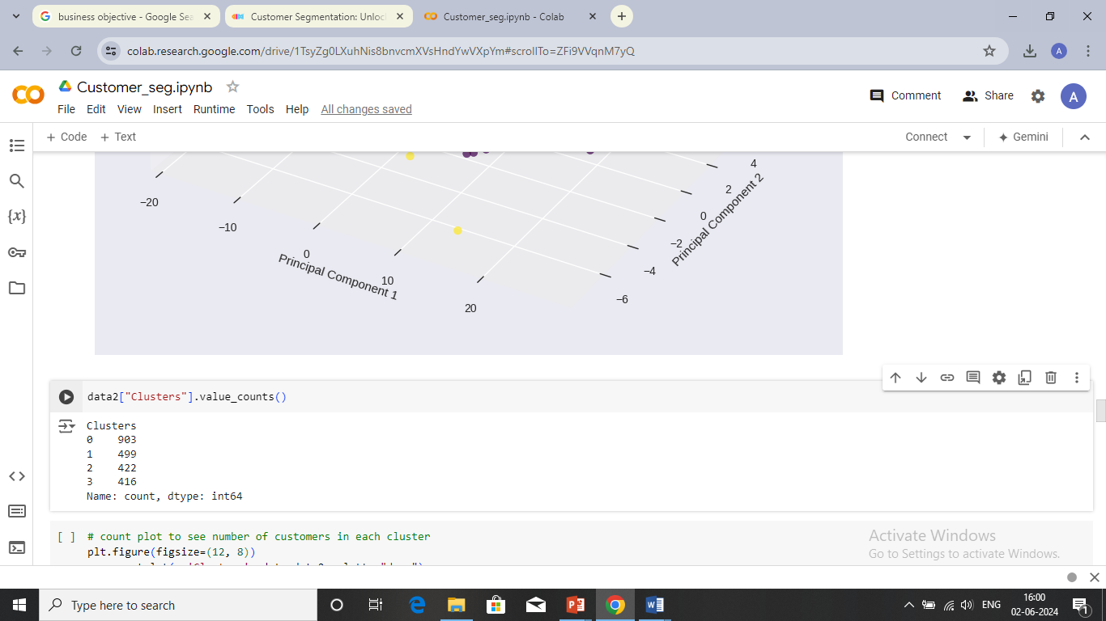
K-means model
Optimum No. of clusters is 4 by elbow curve with an inertia score(sum of squared distances between each data point and its nearest cluster centroid) around 93451.
This Silhouette score, while not very high, suggests that K-Means is able to form somewhat distinct clusters, but there might still be some overlap or outliers.

Slide 20
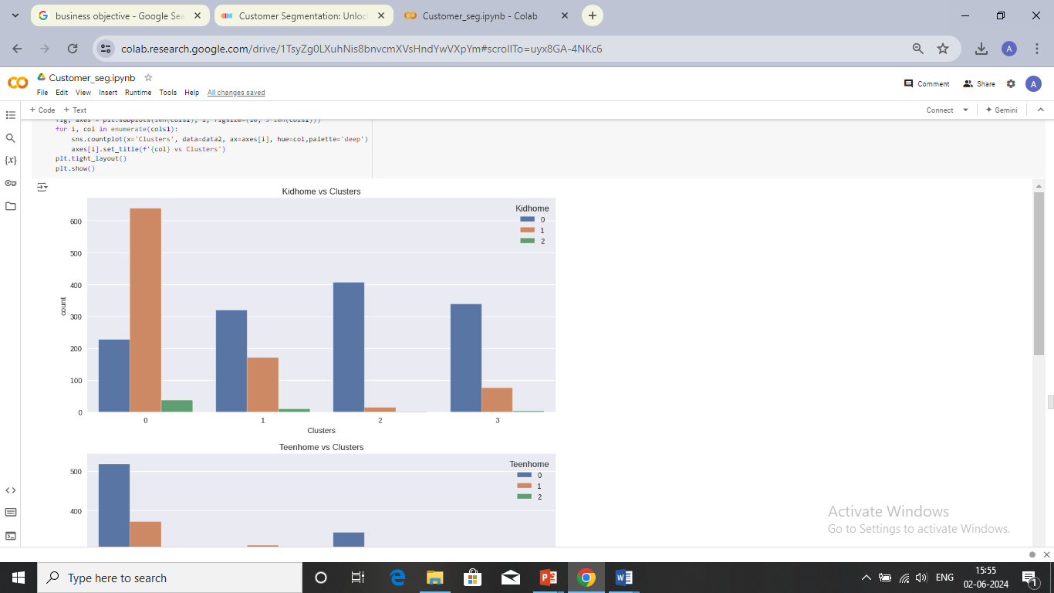
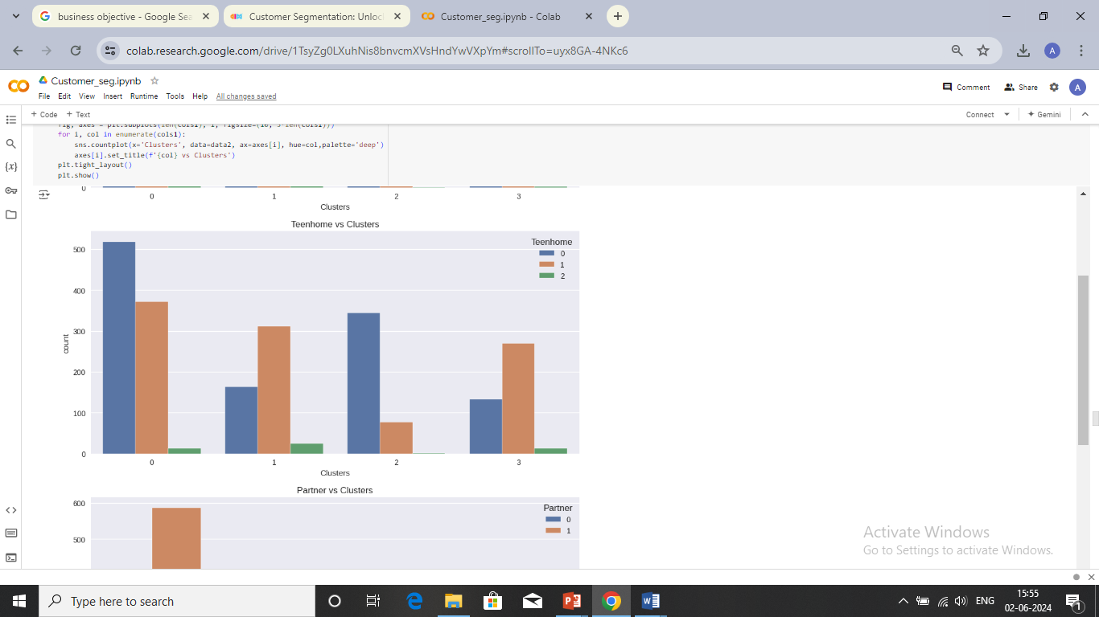
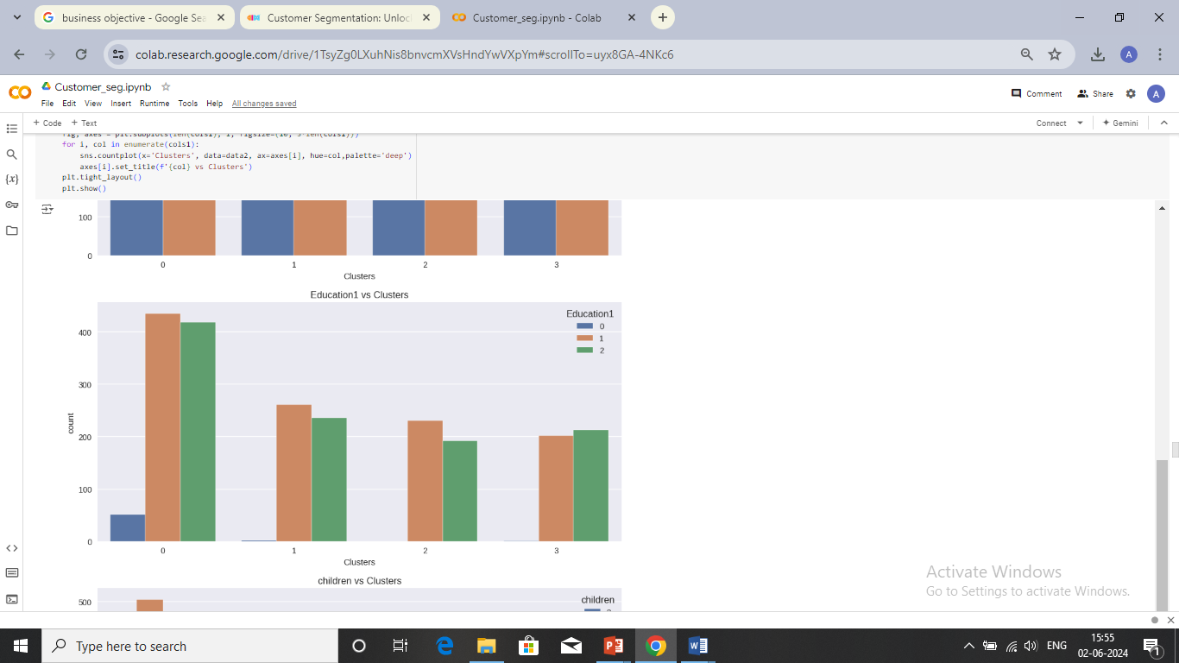
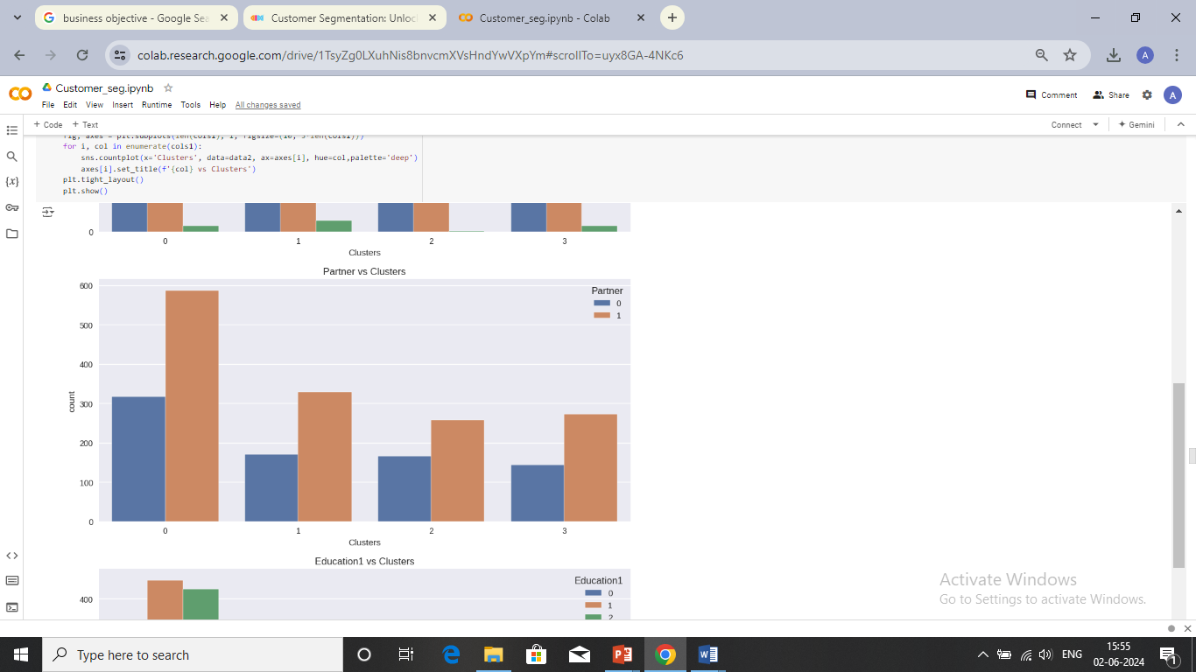
Visualization of Features vs. Clusters

Slide 21
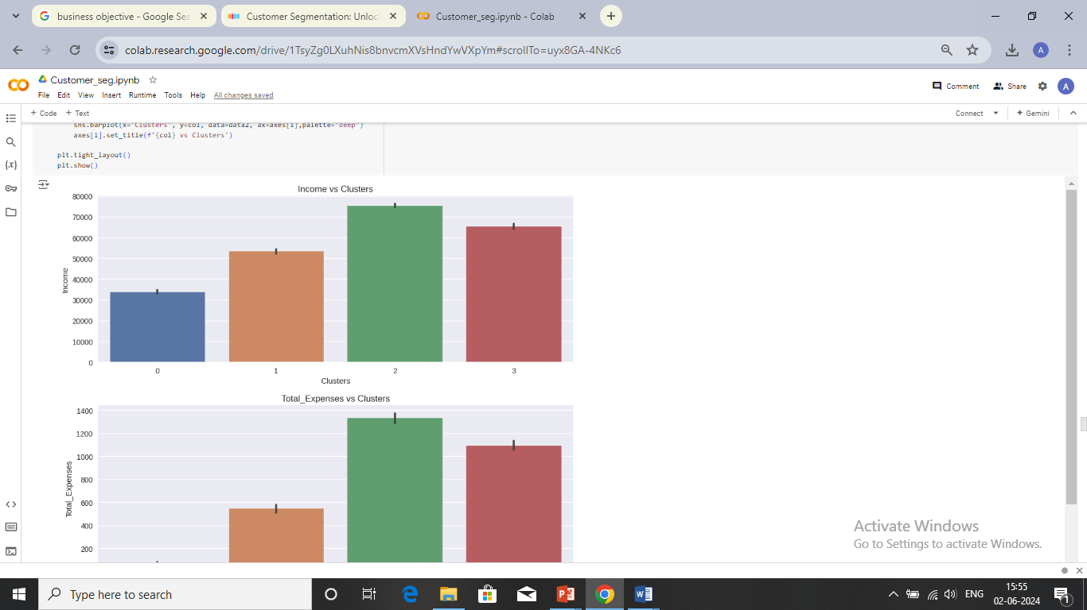
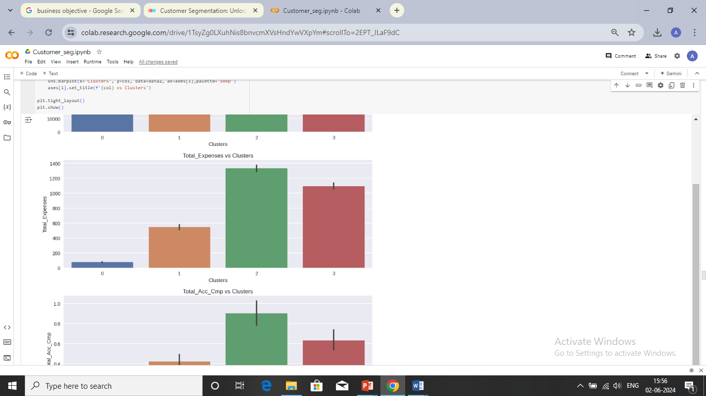
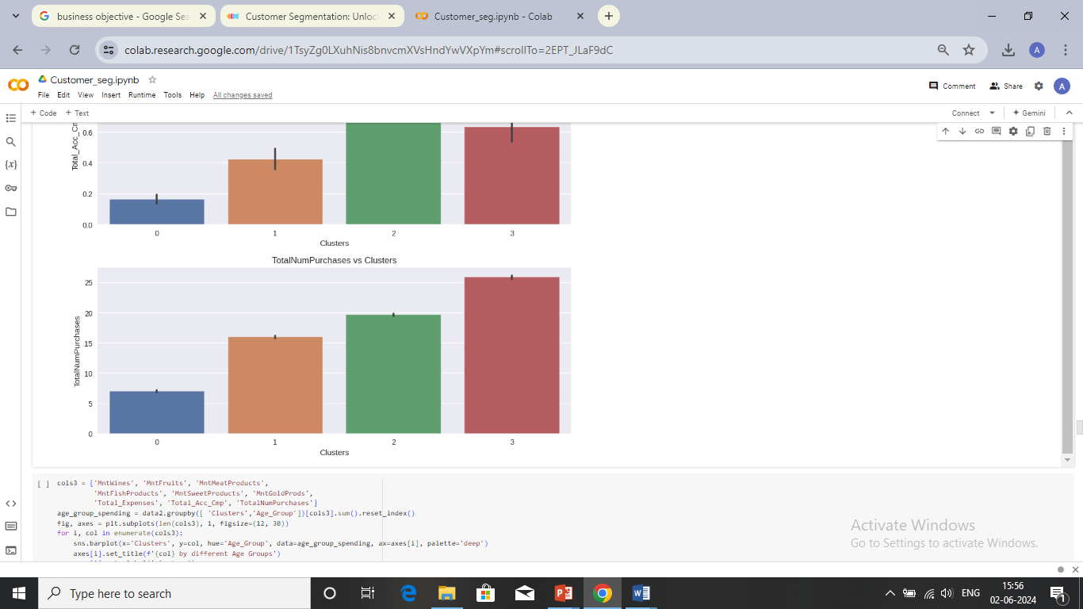
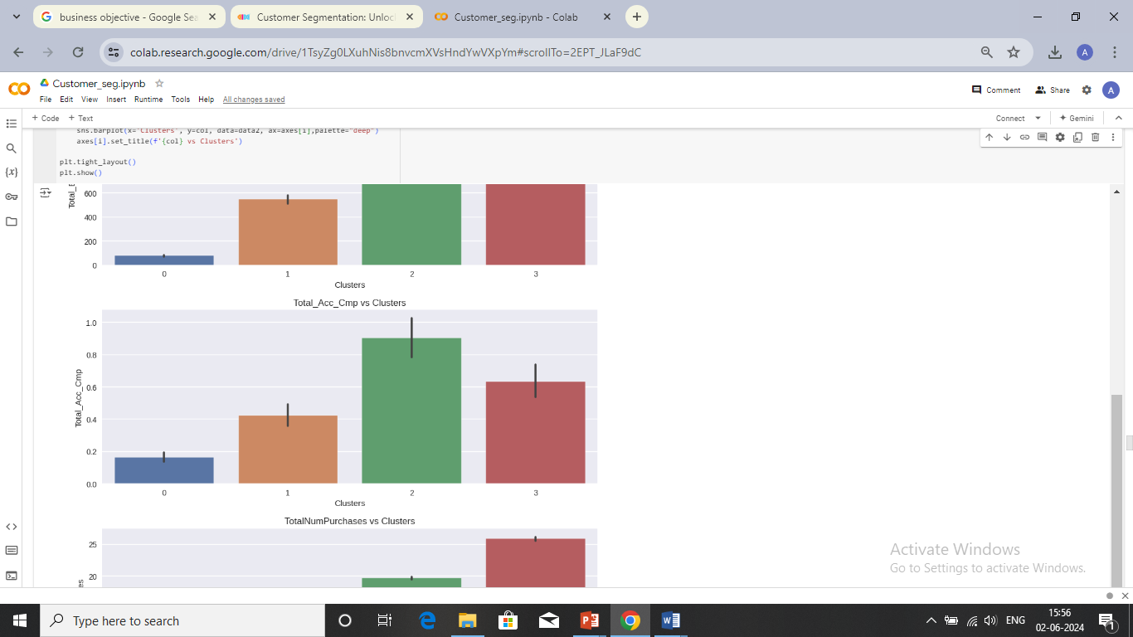

Slide 22
Cluster Observations
Cluster 0:
Highest No. of customers
Most of the households have at least one kid.
Majority of the households doesn't have any teens
With or with out partner.
Most of them have at least one or two child.
Majority of them did their graduation and postgraduation, very few did their basic education.
Low income
Low Expenditure
Very less purchases
Very less accepted campaign
Expenses on different categories are done more by middle aged people.
Higher expenses are made by households having no children.
Post graduate people does higher expenses.
Cluster 1:
Second highest no. of customers
Most of the households doesn't have any kids.
Majority of the households have at least one teen.
With or with out partner.
Majority of them at least one child.
Majority of them did their graduation and postgraduation
Income below 60000
Low Expenditure
Less spending on wines, fruits etc.
Less than 20 purchases
Very less accepted campaign
Expenses on different categories are done more by middle aged people.
Higher expenses are made by households having no children.
Post graduate people does higher expenses.
Cluster 2:
Most of the households doesn't have any kids.
Majority of the households don't have any teens.
With or with out partner.
Well Educated
Mostly Middle aged people, followed by equal no. senior citizens and adults.
Cluster with the highest income
High Expenditure
High spending on wines
High spending on meat products when compared to other clusters.
More than 20 purchases
Accepted a lot of campaigns
Cluster 3:
Most of the households doesn't have any kids.
Majority of the households have at least one teen.
With or with out partner.
Well Educated
Mostly Middle aged people and senior citizens.
High income
High Expenditure
Highest spending on wines
High spending on meat prods.
More than 25 purchases
Accepted a lot of campaigns

Slide 23
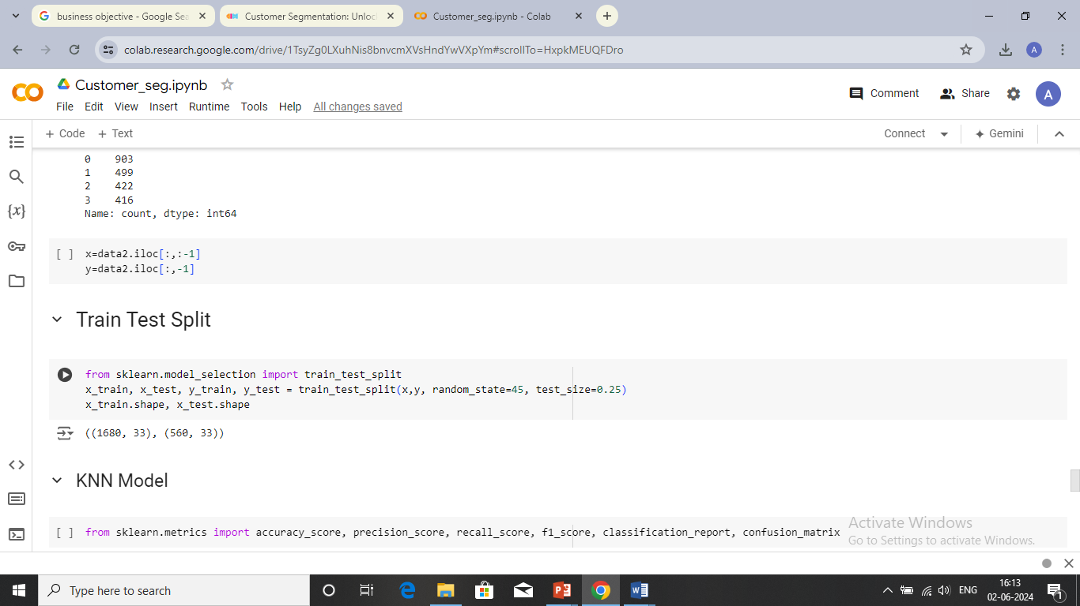
Cluster labels as features
We use the results of K-Means clustering to create a labeled dataset where the cluster the cluster labels are the target variable.
We train the classification model to predict the cluster membership of new data point.
Train-Test Split
Data Splitting: The code splits the original dataset into features (x) and the target variable (y), which is our clusters.
Train-Test Split: The data is split into training and testing. Where 75% of the data goes for training and the rest 25% for testing.

Slide 24
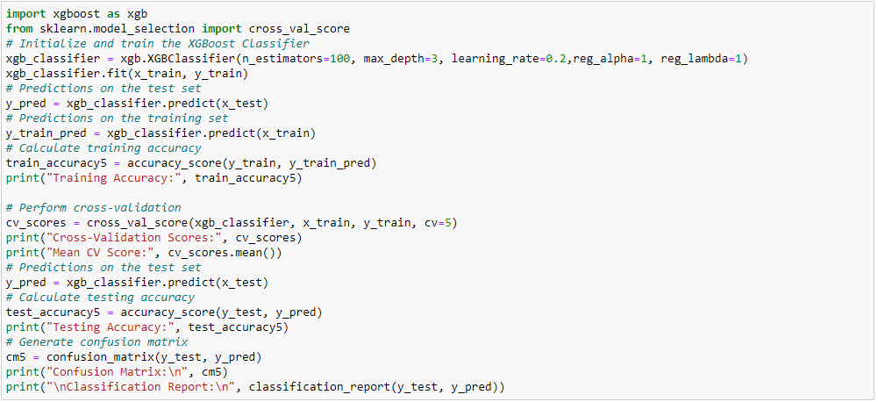
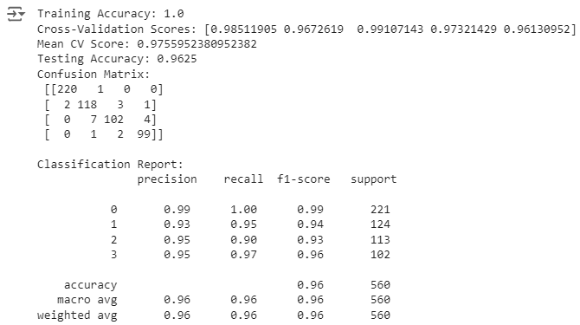
XG-Boost Model Building & Model Evaluation
XG-Boost is a powerful and efficient implementation of gradient boosting for supervised learning tasks. It is known for its high performance and scalability, often used in competitive machine learning competitions and real-world applications.
XG-Boost also shows a good balance. Despite the overfitting, the testing accuracy of 0.96 is very high, indicating that the model still performs well on unseen data. This suggests that, while the model is overfitting, it retains a strong predictive power.

Slide 25
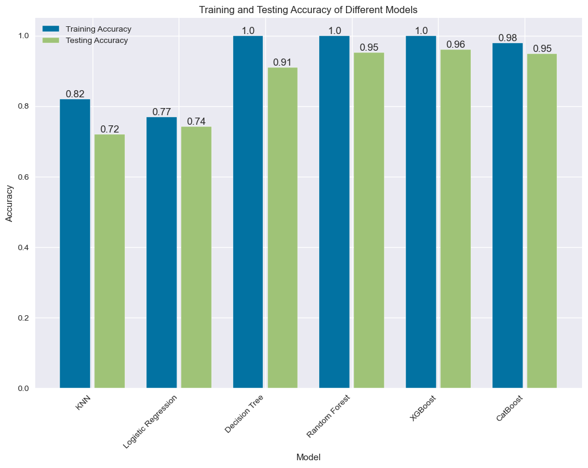
Model Summary

Slide 26
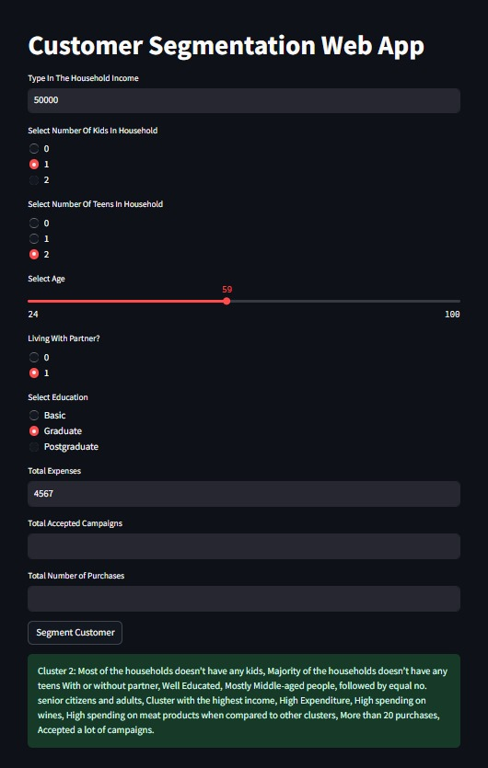
Deployment
By using Streamlit we have deployed the Customer Segmentation Web App.
We have used text inputs for Income, total expenses, total accepted campaigns and total no. of purchases.
Age has been given a slider which ranges from 24 to 100.
Selection of number of kids, teens, living partners and education have been represented with radio input.

Slide 27
conclusion
Most customers have a single dependent/child in their household.
Most customers made purchases via the Store.
Majority of the customers have partners.
Majority of the customers have been Graduates.
Majority of the customers are parents.
Customers that didn't respond to campaigns are the majority.
The earliest enrollments in the business were by customers aged 48.
The total amount spent is highly correlated with customers income and the total purchases they made.
The highest spending age groups are between 40–60
Customers with no dependents/children have been the highest spenders.

Slide 28
Business insights
To address the reluctance of customers in accepting the campaigns and encourage higher participation rates, tailor the campaign offers specifically to the preferences and needs of customers in cluster 1.
To address the challenges of low income and low spending among customers in Cluster 1, develop affordable and cost-effective products that cater to the budget constraints and you can also implement programs that provide incentives if they repeatedly buy a product more than once which will allow the, to continue engaging with the business even with their low income.
Given that the majority of customers make purchases from the stores, it is crucial to maintain a strong presence and optimize the in-store experience and while fewer customers make purchases online, it highlights the potential for growth in the e-commerce channel hence the business should focus on improving website usability.

Slide 29
Thank you

